Slide 1
Chapter 5: Information Privacy

Slide 2
Chapter Overview
Introduction
Perspectives on privacy
Information disclosures
Data mining

Slide 3
5.1 Introduction

Slide 4
Information Technology Erodes Privacy
Information collection, exchange, combination, and distribution easier than ever means less privacy
Scott McNealy: “You have zero privacy anyway. Get over it.”
We will consider how we leave an “electronic trail” of information behind us and what others can do with this info

Slide 5
NON SEQUITUR © 2005 Wiley Ink, Inc. Dist. By UNIVERSAL UCLICK. Reprinted with permission. All rights reserved.

Slide 6
5.2 Perspectives on Privacy

Slide 7
Defining Privacy
Privacy related to notion of access
Access
Physical proximity to a person
Knowledge about a person
Privacy is a “zone of inaccessibility”
Privacy violations are an affront to human dignity
Too much individual privacy can harm society
Where to draw the line?

Slide 8
Harms of Privacy
Cover for illegal or immoral activities
Burden on the nuclear family
Hidden dysfunctional families
Ignored people on society’s fringes

Slide 9
Benefits of Privacy
Individual growth
Individual responsibility
Freedom to be yourself
Intellectual and spiritual growth
Development of loving, trusting, caring, intimate relationships

Slide 10
Is There a Natural Right to Privacy?
Privacy rights stem from property rights: “a man’s home is his castle”
Coercive Acts before American Revolution led to 3rd Amendment to U.S. Constitution
Samuel Warren and Louis Brandeis: People have “the right to be let alone”
Judith Jarvis Thomson: “Privacy rights” overlap other rights
Conclusion: Privacy is not a natural right, but it is a prudential right, meaning that rational agents agree to recognize some privacy rights for the benefit of society

Slide 11
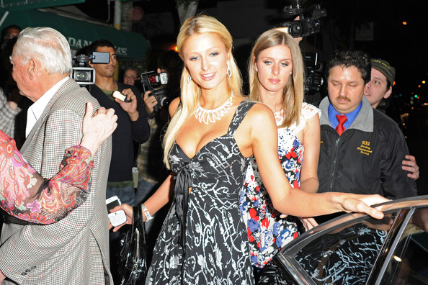
Do People Have the Right to Be Left Alone?

Slide 12
Privacy and Trust
Perhaps modern life is actually more private than life centuries ago
Most people don’t live with extended families
Automobile allows us to travel alone
Television v. public entertainment
Challenge: we now live among strangers
Remedy: establishing reputations
Ordeal, such as lie detector test or drug test
Credential, such as driver’s license, key, ID card, college degree
Establishing reputation is done at the cost of reducing privacy

Slide 13
Case Study: Secret Monitoring
Sullivans have a baby girl
Both work; they are concerned about performance of full-time nanny
Purchase program that allows monitoring through laptop’s camera placed in family room
They do not inform nanny she is being monitored

Slide 14
Rule Utilitarian Evaluation
If everyone monitored nannies, it would not remain a secret for long
Consequences
Nannies would be on best behavior in front of camera
Might reduce child abuse and parents’ peace of mind
Would also increase stress and reduce job satisfaction of child care providers
Might result in higher turnover rate and less experienced pool of nannies, who would provide lower-quality care
Harms appear greater than benefits, so we conclude action was wrong

Slide 15
Social Contract Theory Evaluation
It is reasonable for society to give people privacy in their own homes
Nanny has a reasonable expectation that her interactions with baby inside home are private
Sullivan’s decision to secretly monitor the nanny is wrong because it violates her privacy

Slide 16
Kantian Evaluation
Imagine rule, “An employer may secretly monitor the work of an employee who works with vulnerable people”
If universalized, there would be no expectation of privacy by employees, so secret monitoring would be impossible
Proposed rule is self-defeating, so it is wrong for Sullivans to act according to the rule

Slide 17
Summary
Three analyses have concluded Sullivans were wrong to secretly monitor how well their nanny takes care of their baby
Morally acceptable options
Conduct more comprehensive interview of nanny
More thoroughly check nanny’s references
Spend a day or two at home observing nanny from a distance
Be up-front with nanny about desire to install and use surveillance software on laptop

Slide 18
5.3 Information Disclosures

Slide 19
Public Records
Public record: information about an incident or action reported to a government agency for purpose of informing the public
Examples: birth certificates, marriage licenses, motor vehicle records, criminal records, deeds to property
Computerized databases and Internet have made public records much easier to access

Slide 20
Records Held by Private Organizations
Credit card purchases
Purchases made with loyalty cards
Voluntary disclosures
Posts to social network sites

Slide 21
Data Gathering and Privacy Implications
Facebook tags
Enhanced 911 services
Rewards or loyalty programs
Body scanners
RFID tags
Implanted chips
OnStar
Automobile “black boxes”
Medical records
Digital video recorders
Cookies and flash cookies

Slide 22
Facebook Tags
Tag: Label identifying a person in a photo
Facebook allows users to tag people who are on their list of friends
About 100 million tags added per day in Facebook
Facebook uses facial recognition to suggest name of friend appearing in photo
Does this feature increase risk of improper tagging?

Slide 23
Enhanced 911 Services
Cell phone providers in United States required to track locations of active cell phones to within 100 meters
Allows emergency response teams to reach people in distress
What if this information is sold or shared?

Slide 24
Rewards or Loyalty Programs
Shoppers who belong to store’s rewards program can save money on many of their purchases
Computers use information about buying habits to provide personalized service
ShopRite computerized shopping carts with pop-up ads
Do card users pay less, or do non-users get overcharged?

Slide 25
Body Scanners
Some department stores have 3-D body scanners
Computer can use this information to recommend clothes
Scans can also be used to produce custom-made clothing

Slide 26
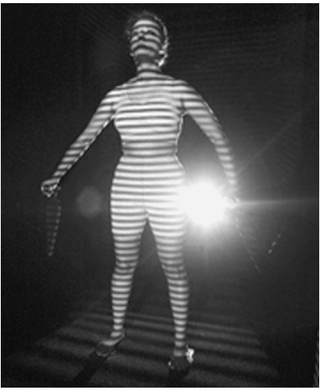
Body Scanner Takes Measurements
AP Photo/Richard Drew

Slide 27
RFID Tags
RFID: Radio frequency identification
An RFID tag is a tiny wireless transmitter
Manufacturers are replacing bar codes with RFID tags
Contain more information
Can be scanned more easily
If tag cannot be removed or disabled, it becomes a tracking device

Slide 28
Implanted Chips
Taiwan: Every domesticated dog must have an implanted microchip
Size of a grain of rice; implanted into ear
Chip contains name, address of owner
Allows lost dogs to be returned to owners
RFID tags approved for use in humans
Can be used to store medical information
Can be used as a “debit card”

Slide 29
OnStar
OnStar manufactures communication system incorporated into rear-view mirror
Emergency, security, navigation, and diagnostics services provided subscribers
Two-way communication and GPS
Automatic communication when airbags deploy
Service center can even disable gas pedal

Slide 30
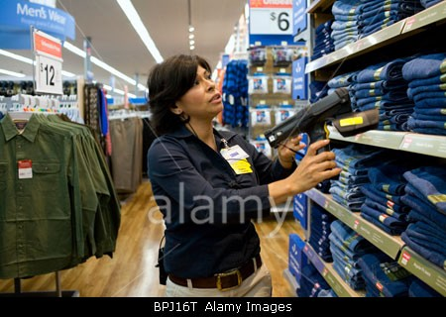
RFID Tags Speed Inventory Process
Employees take inventory more quickly and make fewer errors when items are marked with RFID tags

Slide 31
Automobile “Black Boxes”
Modern automobiles come equipped with a “black box”
Maintains data for five seconds:
Speed of car
Amount of pressure being put on brake pedal
Seat belt status
After an accident, investigators can retrieve and gather information from “black box”

Slide 32
Medical Records
Advantages of changing from paper-based to electronic medical records
Quicker and cheaper for information to be shared among caregivers
Lower medical costs
Improve quality of medical care
Once information in a database, more difficult to control how it is disseminated

Slide 33
Digital Video Recorders
TiVo service allows subscribers to record programs and watch them later
TiVo collects detailed information about viewing habits of its subscribers
Data collected second by second, making it valuable to advertisers and others interested in knowing viewing habits

Slide 34
Cookies
Cookie: File placed on computer’s hard drive by a Web server
Contains information about visits to a Web site
Allows Web sites to provide personalized services
Put on hard drive without user’s permission
You can set Web browser to alert you to new cookies or to block cookies entirely

Slide 35
Flash Cookies
Flash cookie: File placed on your computer’s hard drive by a Web server running the Adobe Flash Player
Flash cookie can hold 25 times as much information as a browser cookie
Flash cookies not controlled by browser’s privacy controls
Some Web sites use flash cookies as a way of backing up browser cookies. If you delete browser cookie, it can be “respawned” from the flash cookie
Half of 100 most popular Web sites use flash cookies

Slide 36
5.4 Data Mining

Slide 37
Data Mining
Searching records in one or more databases, looking for patterns or relationships
Can be used to profiles of individuals
Allows companies to build more personal relationships with customers

Slide 38
Google’s Personalized Search
Secondary use: Information collected for one purpose use for another purpose
Google keeps track of your search queries and Web pages you have visited
It uses this information to infer your interests and determine which pages to return
Example: “bass” could refer to fishing or music
Also used by retailers for direct marketing

Slide 39
Secondary Uses of Information

Slide 40
Collaborative Filtering
Form of data mining
Analyze information about preferences of large number of people to predict what one person may prefer
Explicit method: people rank preferences
Implicit method: keep track of purchases
Used by online retailers and movie sites

Slide 41
Ownership of Transaction Information
Who controls transaction information?
Buyer?
Seller?
Both?
Opt-in: Consumer must explicitly give permission before the organization can share info
Opt-out: Organization can share info until consumer explicitly forbid it
Opt-in is a barrier for new businesses, so direct marketing organizations prefer opt-out

Slide 42
Credit Reports
Example of how information about customers can itself become a commodity
Credit bureaus
Keep track of an individual’s assets, debts, and history of paying bills and repaying loans
Sell credit reports to banks, credit card companies, and other potential lenders
System gives you more choices in where to borrow money
Poor credit can hurt employment prospects

Slide 43
Microtargeting
Political campaigns determine voters most likely to support particular candidates
Voter registration
Voting frequency
Consumer data
GIS (Geographical Information System) data
Target direct mailings, emails, text messages, home visits to most likely supporters

Slide 44
Marketplace: Households
Lotus Development Corporation developed CD with information on 120 million Americans
Planned to sell CD to small businesses that wanted to create mailing lists based on various criteria, such as household income
More than 30,000 consumers complained to Lotus about invasion of privacy
Lotus dropped plans to sell CD

Slide 45
Facebook Beacon
Fandango, eBay, and 42 other online businesses paid Facebook to do “word of mouth” advertising
Facebook users surprised to learn information about their purchases was shared with friends
Beacon was based on an opt-out policy
Beacon strongly criticized by various groups
Facebook switched to an opt-in policy regarding Beacon

Slide 46
Netflix Prize
Netflix offered $1 million prize to any group that could come up with a significantly better algorithm for predicting user ratings
Released more than 100 million movie ratings from a half million customers
Stripped ratings of private information
Researchers demonstrated that ratings not truly anonymous if a little more information from individuals was available
U.S. Federal Trade Commission complaint and lawsuit
Netflix canceled sequel to Netflix Prize

Slide 47
Social Network Analysis
Data mining now incorporating information collected from social networks
Examples
Cell phone companies in India identify “influencers”
Police predict locations of big parties
Strategic deployment of police officers results in a big save of overtime pay and a big drop in criminal activity
Banks evaluate the riskiness of loans

Slide 48
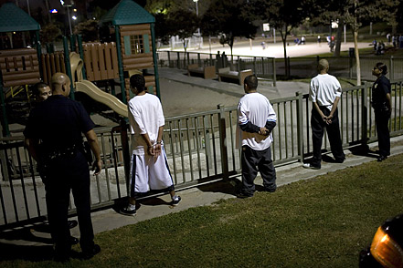
Police Monitor Facebook and Twitter to Identify Locations of Big Parties

